Slide 1

Where is the best place to eat in NYC?
Quoc-Daniel Nguyen
April 23-24, 2019

Slide 2
Overview
What is OpenTable?
Why do we care?
Scraped Data
Analysis
Findings
Future Work
Questions

Slide 3
What is OpenTable?
Online restaurant reservation service
Founded in 1998, HQ in San Francisco
Valued at 2.6 billion in 2014
More than 20 countries: Spain, Ireland, Germany, US, UK, Japan, India, Australia, Mexico
1 million reviews a month, 124 million diners per month, 48,000 restaurants

Slide 4
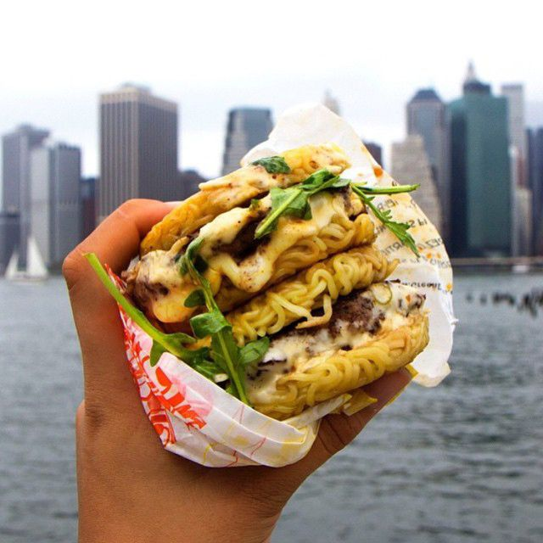

Why do we care?
Personal
VS.
Business
Notes:
Personal
NYC has a big food scene, and unlike other places in the US most of the restaurants aren’t chains, so you don’t know how it is. Where to eat? What type of food? How Expensive? Where to live? Where to show family around?
Business
What’s the most popular cuisines? Which cuisines need more exposure? Which areas have low reviews, avoid those areas or expand those areas. Where do people want to live, drives rent prices because it’s more popular food area. Stores because people know people will come to eat there.

Slide 5
Scraped Data
Restaurant
Location
Cuisine
Price
Ratings (Food, Service, Ambience, Value)
Number of Reviews and Recommendation Percentage
Scarpetta

Slide 6
Analysis

Slide 7
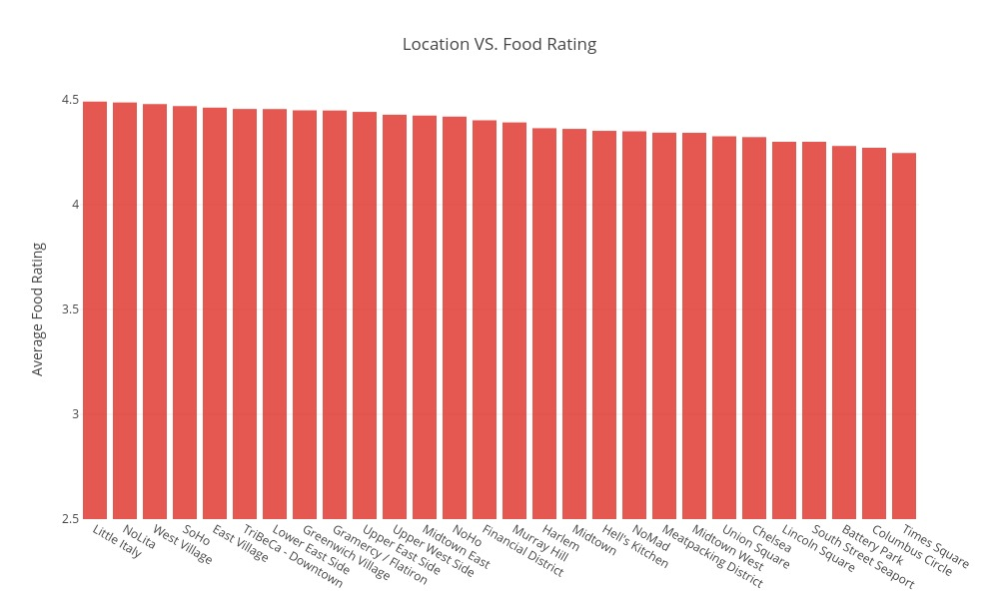
Interactive

Slide 8
Limitations
Not all restaurants are on OpenTable
Searched only Manhattan
Date of reservation
Some locations have very few restaurants (count < 5)
Bar/Pub type restaurants are included (Noise)
Lower price has a higher variance in rating (Price)
Not all restaurants have a known chef (Credibility)

Slide 9
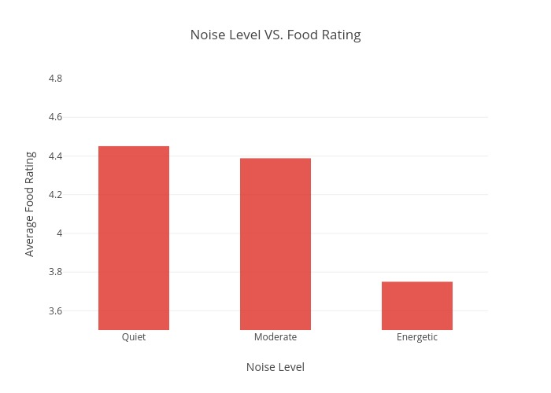
Interactive

Slide 10
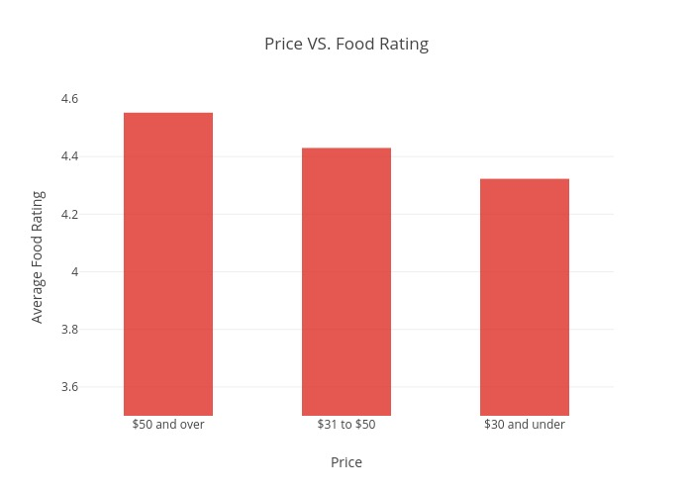
Interactive

Slide 11
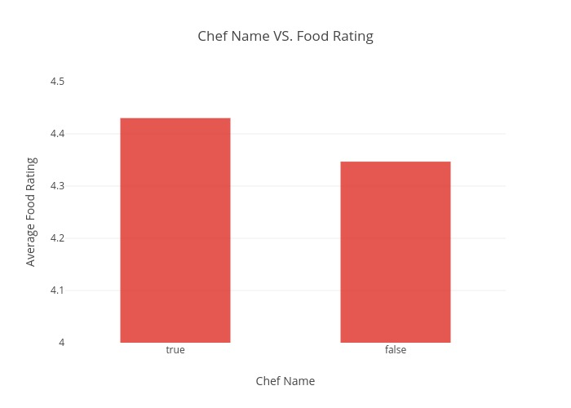
Interactive

Slide 12
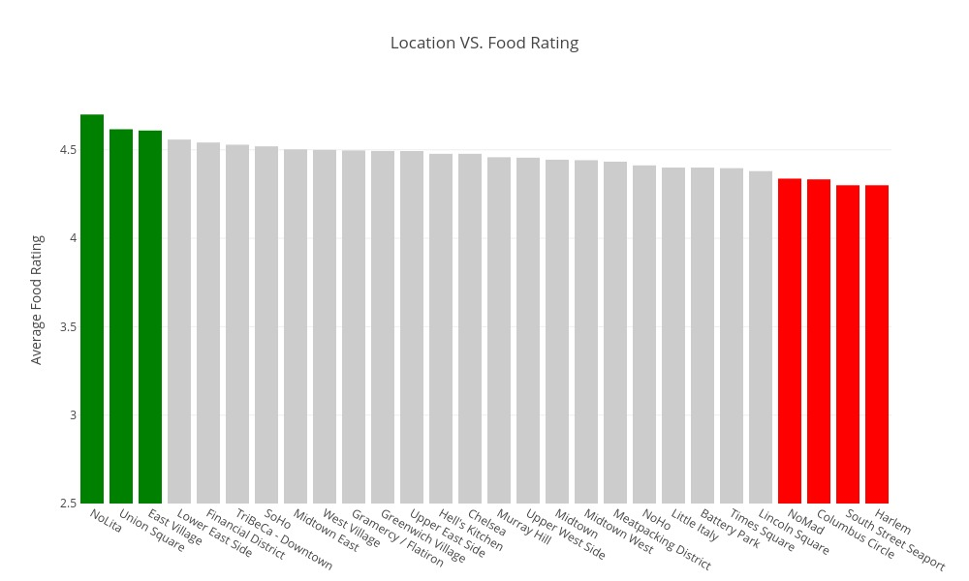
Interactive

Slide 13
Future Work

Slide 14
References
https://www.opentable.com/
http://press.opentable.com/static-files/3f990a9c-0702-4496-9b80-5b90198d056a

Slide 15
Questions?

